Slide 1
Metallic Bonding

Slide 2
Metals in the Periodic Table

Slide 3


Group {1}1 elements are known as the alkali metals.
All alkali metals are highly reactive and, due to having 1 valence electron, form ions with a charge of +1.
The alkali metals are lithium (Li), sodium (Na), potassium (K), rubidium (Rb), cesium/caesium (Cs) and francium (Fr,).
Reactivity increases as you move down the group. This is because the valence electrons are getting further from the nucleus, and are easier to remove.

Slide 4
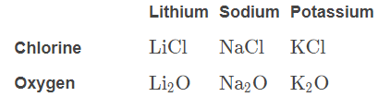
Alkali metals will react to produce similar compounds.
For example:
They will all react with chlorine to form ionic compounds with the formula XCl, where X is an alkali metal.
They will all react with oxygen to form ionic compounds with the formula X₂​O, where X is an alkali metal.

Slide 5
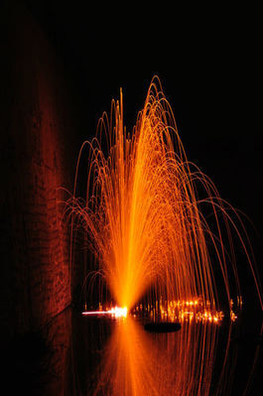
Alkali metals are very soft and you can cut most of them with a knife.
Alkali metals react violently with water. Any alkali metals stored in your school will probably be completely submerged in oil to avoid unwanted reactions.

Slide 6

Group 2 elements are known as the alkaline earth metals.
All alkaline earth metals are reactive (though not as reactive as alkali metals), and, due to having 2 valence electrons, form ions with a charge of +2.
Reactivity increases as you move down the group. This is because the valence electrons are getting further from the nucleus, and are easier to remove.

Slide 7
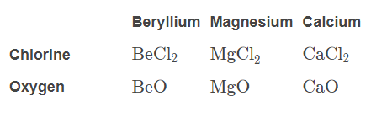
Alkaline earth metals react to produce similar compounds.
For example:
They will all react with chlorine to form ionic compounds with the formula XCl₂​, where X is an alkaline earth metal.
They will all react with oxygen to form ionic compounds with the formula, XO where X is an alkaline earth metal.

Slide 8
Metallic Substances

Slide 9
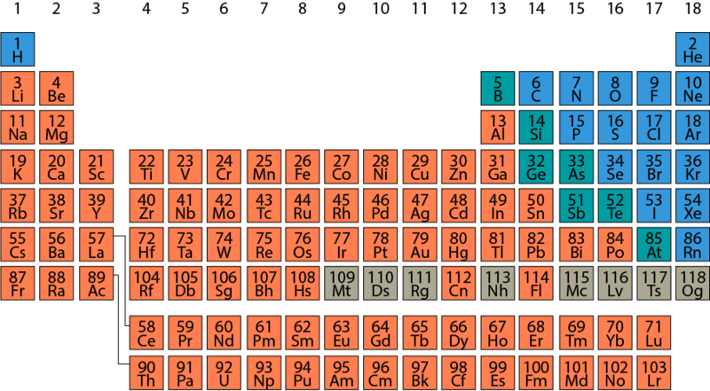
Metals make up the majority of known elements.
Metals are found on the lower left side of the periodic table. As such, they generally have low numbers of valence electrons. As would be expected from such a broad group, the properties of metals vary quite widely.
Valence electrons are the electrons in the outermost electron shell of an atom.
Metals follow trends within the periodic table. Elements within the same group (column on the periodic table) have similar properties because they have the same number of valence electrons. Atoms of elements in the same period (row on the table) are similar in size, because they have the same number of electron shells. Thus, the size of atoms increases down each group.

Slide 10
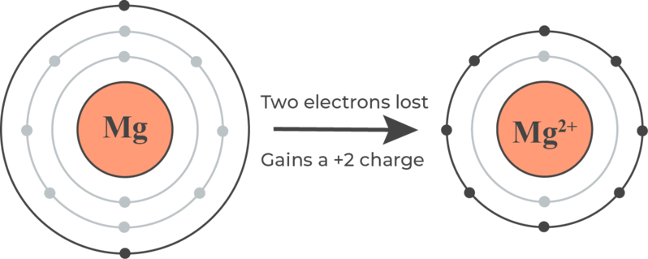
As metals have low numbers of valence electrons, they will tend to lose those electrons to attain a stable full valence shell. Thus, they will form cations.
Atoms with the same number of electrons in their valence shell (in the same group) will tend to react in the same way. For metals, the fewer valence electrons they have, the easier it is to achieve a full valence shell, and the more reactive they will be.
Electrons are attracted to the positive nucleus of an atom, so the closer they are to the nucleus, the more strongly they are held by it. This means that the reactivity of metals increases down the group in the periodic table. The larger metal atoms hold their valence electrons more weakly, so it is easier for them to lose them in reactions.
Electrostatic attraction is the attractive force between electrically charged objects. Like charges repel, while opposite charges attract.

Slide 11
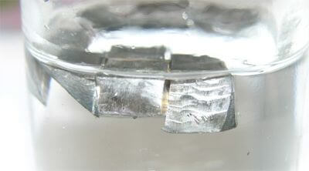
The metals found in group 1 of the periodic table are known as the alkali metals.
The alkali metals all have only one valence electron. This makes them extremely reactive, and they grow more reactive down the group. These metals must be stored in oil, because they react violently with water.
All of the alkali metals occur in nature, but always in compounds with other elements due to their reactivity. Although hydrogen is found in this group, it is not considered a metal because it is a gas at room temperature. However, at very high pressures it displays the same properties.

Slide 12
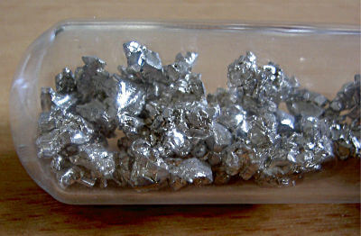
The metals found in group 2 of the periodic table are known as the alkaline earth metals.
These metals all have two valence electrons. They are not as reactive as the group 1 metals, but they are still very reactive, and grow more reactive down the group. The metals further down the group (calcium, strontium, and barium) will react vigorously with water.
All of the alkaline earth metals occur in nature, always in compounds with other elements due to their reactivity. All of the group 2 metals have at least one naturally occurring radioisotope, meaning they can all be found in radioactive forms.
A radioisotope is an isotope (a form of an element with a different number of neutrons) that is unstable and undergoes radioactive decay.

Slide 13
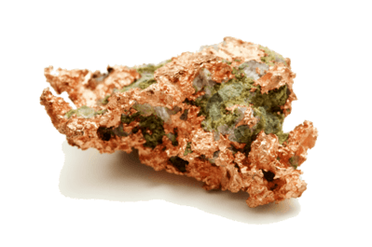
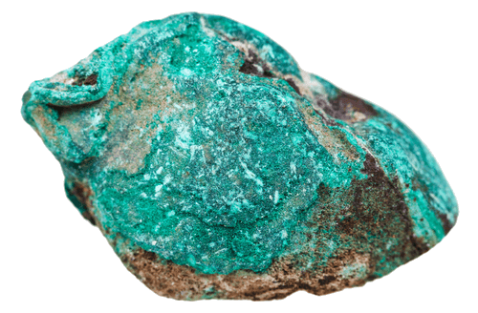
The metals found in groups 3-12 of the periodic table are known as the transition metals.
The properties of transition metals vary greatly. Many of them occur in nature as metals, but they also commonly form brightly coloured compounds. Some transition metals are magnetic.
Due to the unique properties of their energy levels, transition metals can form a range of cations with different charges, by losing different numbers of valence electrons. In writing, these different ions are denoted by their charge in Roman numerals; for example, Cu⁺ ion is called the copper(I) ion, and the Cu²⁺ ion is the copper (II) ion.

Slide 14
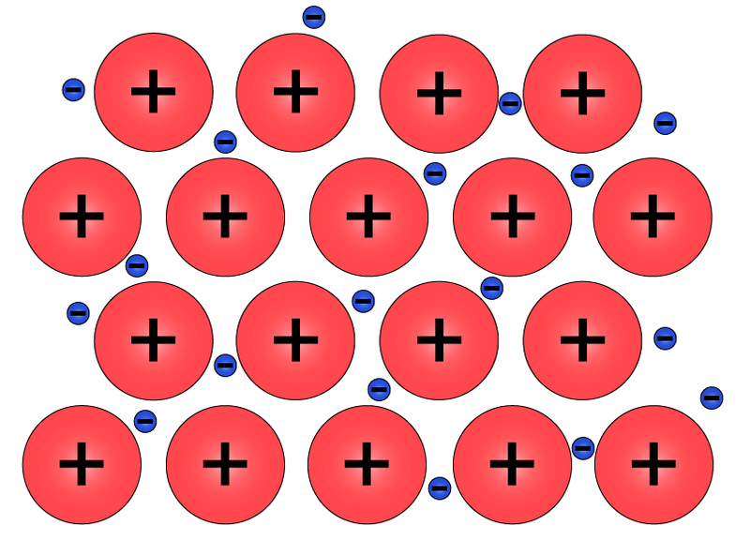
Atoms of metals can bond with each other by sharing electrons between many atoms.
The valence electrons of the metal atoms become delocalised, disconnecting from their nuclei. Each of the atoms becomes a cation.
This structure is held together by the strong electrostatic forces of attraction between the positively charged cations and the negatively charged electrons.

Slide 15
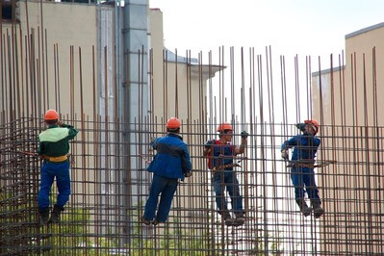
The strength of metallic bonds varies according to the metal’s chemical properties.
Metals with more valence electrons have more delocalised electrons and more strongly charged cations. This means that the metallic bonds within them will be stronger.
Metallic bonds also grow stronger towards the top of the periodic table, as atoms are smaller. Thus, the delocalised electrons are closer to the nucleus and attracted to it more strongly.

Slide 16
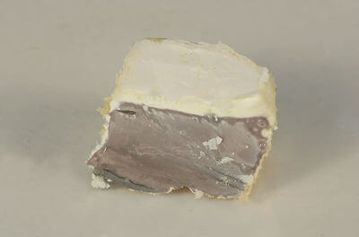
As an example, we’ll compare the bonding in sodium and magnesium.
Sodium has atomic number 11, so it has an electron configuration of 2, 8, 1,2,8,1, and 11 electron in the valence shell. When sodium forms metallic bonds, this single valence electron is delocalised and shared between the lattice of sodium cations.
Magnesium has atomic number 12, so it has 22 electrons in its valence shell. When magnesium forms metallic bonds, both electrons are delocalised from each atom (forming cations), so the cations have a charge of +2 and will be more strongly attracted to the delocalised electrons. Thus, the metallic bonding in magnesium is stronger than in sodium.

Slide 17
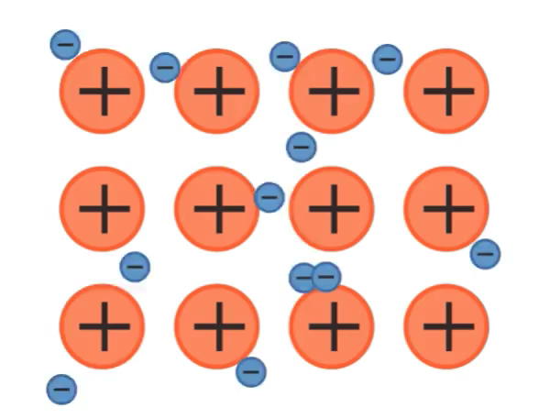
The cations form a lattice structure, with electrons moving between them.
The electrons are attracted equally to all of the cations, so they are free to move between them. The cations are repelled from each other, but held together by their attractions to the electrons.
This results in a three-dimensional network, with cations equally spaced in fixed positions and a sea of delocalised electrons between them. Metallic bonds are non-directional, as the electrons are equally attracted to all of the cations, and move between them randomly.

Slide 18

The metallic lattice is neutral overall.
The valence electrons of each cation are still present within the structure. Thus, despite each nucleus in the lattice being a cation, metals are still considered to be made up of atoms. When discussing a pure metal, we use its atomic symbol; sodium metal, for example, is Na+.

Slide 19
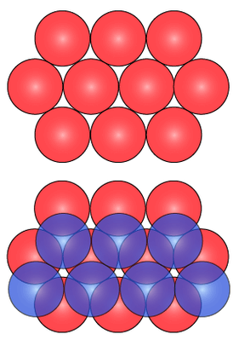
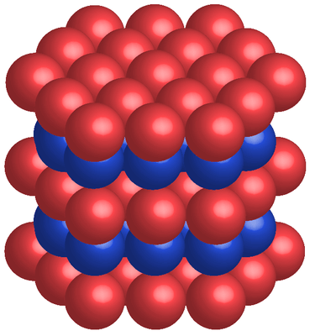
Most metals are close packed; they fit as many atoms as possible into the available volume.
In a close packed lattice structure, every cation is surrounded by 12 other cations. Some metallic lattices have other structures, but this is the most common. We can visualise how ions pack together within the metallic lattice by imagining them as spheres.
Imagine first a single layer of a magnesium metallic lattice. Each cation within the layer is surrounded by 6 other cations. Now, place an identical layer on top and another on the bottom, such that cations are packed as efficiently as possible. This means that the cations in the middle layer will fit into the gaps between cations in the other layers, so each is touching 3 cations above and 3 cations below.

Slide 20
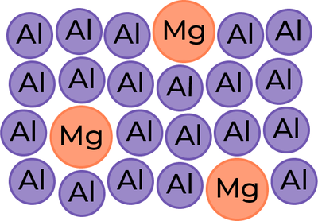
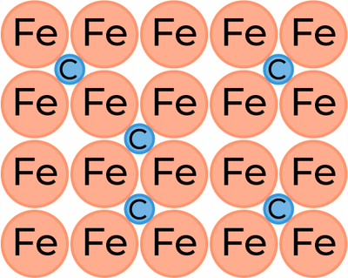
While metallic bonds commonly occur between atoms of the same element, they can also occur between different metals, or even with non-metals; this is called an alloy.
The structure of the metallic lattice is different in alloys, as they may include cations with different sizes and charges. Often the alloys used by humans have very small proportions of other metals, so they cannot fit in a regular place in the lattice structure.
A substitutional alloy is one where the cations of the two metals are similar in size, and can substitute for each other in the lattice structure. As they will not be exactly the same size, this causes some disruption to the lattice. An interstitial alloy is one where one metal has much smaller cations, and they fit in the spaces between the other metal’s lattice (interstices). Some alloys have non-metals such as carbon mixed in; these disrupt the bonding further, as they cannot form metallic bonds.

Slide 21
Physical Properties of Metallic Substances

Slide 22
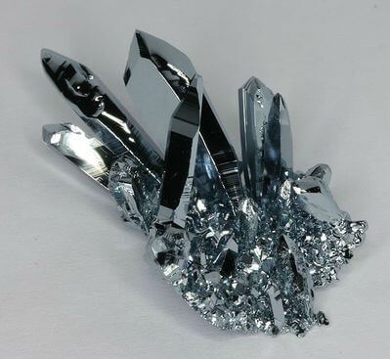
The properties of metals vary widely, but most metals share particular properties.
These properties can be explained by the way metallic bonding occurs. Metals are crystalline solids, where metallic cations are held in a rigid lattice by their electrostatic attractions to a sea of delocalised electrons. It is this structure that gives rise to their distinct properties.

Slide 23
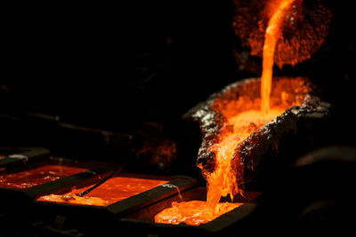
Metals have high melting and boiling points.
This is because the strong electrostatic forces of attraction between the cations of the lattice and the sea of electrons take a large input of energy to overcome.
The melting and boiling points of metals vary according to the strength of their bonds, which are determined by the number of valence electrons and the size of the cations. Metals with more valence electrons (and thus more delocalised electrons and stronger attractions) and smaller cations (and thus more exposed positive nuclei and stronger attractions) have stronger bonds.

Slide 24
Most metals are relatively hard and dense.
The hardness of a substance is also related to the strength of its bonding. The strong electrostatic forces between cations and electrons take a lot of kinetic energy to break.
In addition, the cations are held in a rigid lattice which is closely packed. Metals are able to form in the most efficient structures possible, because their cations while repelled from each other, are strongly attracted to the electrons all around them. This means that metals are usually very dense.

Slide 25
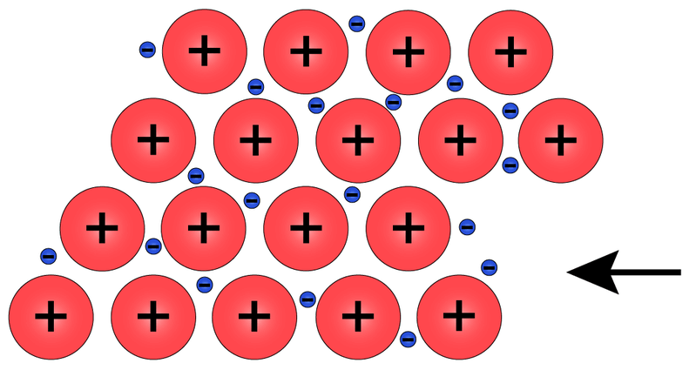
Metals are malleable and ductile.
Something which is malleable is able to be worked into a different shape without breaking. Something which is ductile is able to be drawn out or stretched without breaking.
The attractive forces in metallic bonding are strong, but they are also non-directional. The cations can move past each other without disrupting the forces between the cations and the sea of electrons. This means that the lattice is hard to separate, but easy to deform.

Slide 26
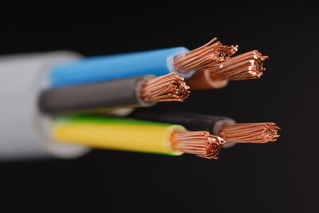
Metals are good conductors of electricity.
Electrical conductivity requires charged particles that are able to move freely. The metallic lattice hosts a sea of delocalised electrons which are free to move throughout the structure.
When a current is applied to a metal (in either solid or liquid form), the delocalised electrons will be attracted to the positive electrode and be able to move through the metal towards it, thus allowing current to flow.

Slide 27
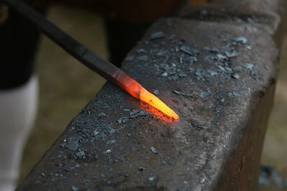
Metals are good conductors of heat.
When a metal is heated, the cations in the metallic lattice vibrate faster, and as they are closely packed they can transfer this heat energy quickly through the structure.
The delocalised electrons can gain kinetic energy from the heat, and as they are free to move through the lattice they will transfer it physically to other parts of the lattice.

Slide 28
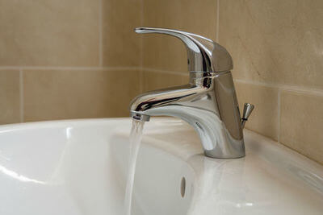
Metals are not soluble in any solvent.
The electrostatic forces of attraction between cations and delocalised electrons are stronger than the forces of attraction between these particles and the solvent particles.
Metals may react with water and other liquids; this is not the same as being soluble in them. When chemical reactions occur, new chemical bonds are formed as the atoms involved exchange or share their valence electrons. Dissolution involves the electrostatic attractions between the solvent and solute (substance being dissolved) overcoming those within the solute, without new bonds forming or electrons being exchanged.

Slide 29

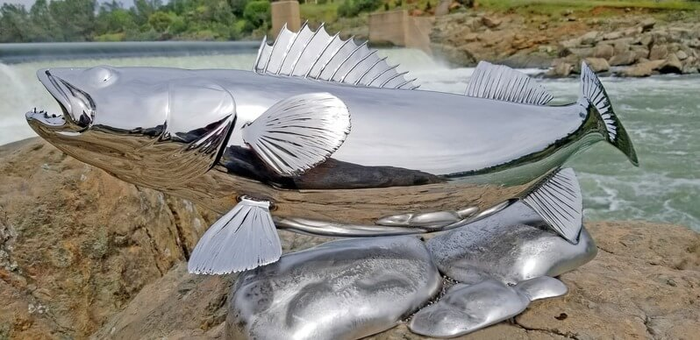
Metals are lustrous.
Lustre is the property of being shiny, of reflecting the light. The mobile electrons of metals may move across the surface. They can move freely, so any light that falls on them is reflected back. The fluid nature of the delocalised electrons means metals have a smooth surface, so light rays are reflected at consistent angles and make the metal appear shiny.
Many metals will tarnish; their outer layer reacts with air and water to produce metal oxides that are duller than the pure metal. Sometimes these oxides are different colours, such as the red of iron rust, Fe₂​O₃​, or the green of copper verdigris, Cu₂​CO₃​(OH)₂​. This tarnish can usually be removed by polishing or chemical treatment. Less reactive metals such as gold and platinum will remain shiny for long periods of time.

Slide 30
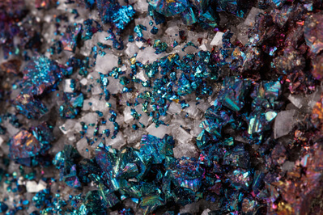
People use metals for a wide variety of purposes.
Some metals, namely those which are not very reactive and thus are found naturally in pure form, have been used since ancient times. Other, more reactive metals must be extracted from their ores in order to be used.
Ores are rocks that comprise mixtures of different compounds from which it’s economically viable to extract a metal. How difficult it is to extract a metal from its ore depends on the reactivity of the metal.

Slide 31

Alkali metals, found in group 1 of the periodic table, are very reactive, and soft enough to be cut with a knife.
They also have lower densities and melting points than most other metals, though these are still high relative to many other substances. The alkali metals have larger atoms than the other metals in the same period. This means that their lattice structures are not as efficiently packed together, so they are less dense than most metals.
Sodium is used in street lamps, where vaporising the sodium gives a distinctive yellow glow. Lithium is used in rechargeable batteries, because it is relatively light and highly reactive, making it a convenient, efficient conductor.

Slide 32

The alkaline earth metals, in group 2, are less reactive, harder, and have higher melting points than the alkali metals, but they are still distinct from other metals in these respects.
Magnesium is used as a major component in alloys, because it is both strong and light. The salts of alkaline earth metals burn with a variety of bright colours (strontium burns red, calcium orange, barium green), so they are commonly used in fireworks. Beryllium is transparent to X-rays due to its low density, so it is used in X-ray windows.

Slide 33

The transition metals, in groups 3-12, are generally harder, denser, and have higher melting points than the other metals.
They form coloured compounds, and some are magnetic. The transition metals are the most widely used group, as they are not highly reactive like the alkali and alkaline earth metals, and they have a wide range of properties.
The coloured compounds of transition metals are used extensively as pigments in paints, and to colour glass, ceramics and enamel. The colours of many gemstones are also due to the presence of transition metals.

Slide 34
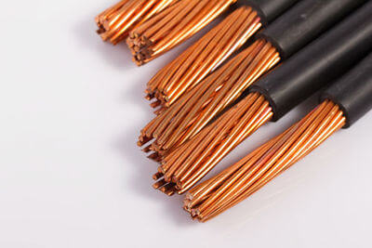
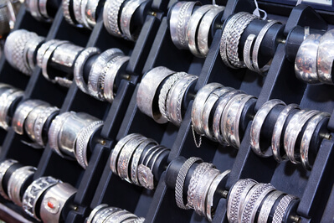

Transition metals have a wide variety of practical as well as aesthetic uses.
Copper is commonly used in electrical wiring, as it is highly ductile and a good conductor. Gold and silver are used in jewellery due to their malleability and attractive lustre. Gold is also used in sensitive electrical contacts, as it is more conductive than copper but also more expensive.
Titanium is relatively light and very strong, so it’s used a lot in construction. Iron is also used frequently due to its strength, usually in alloys as it is prone to rusting. Iron and nickel are the metals usually used in magnets. In addition, iron and nickel comprise the core of the Earth, and the movement of the molten outer core generates Earth's magnetic field.

